Slide 1
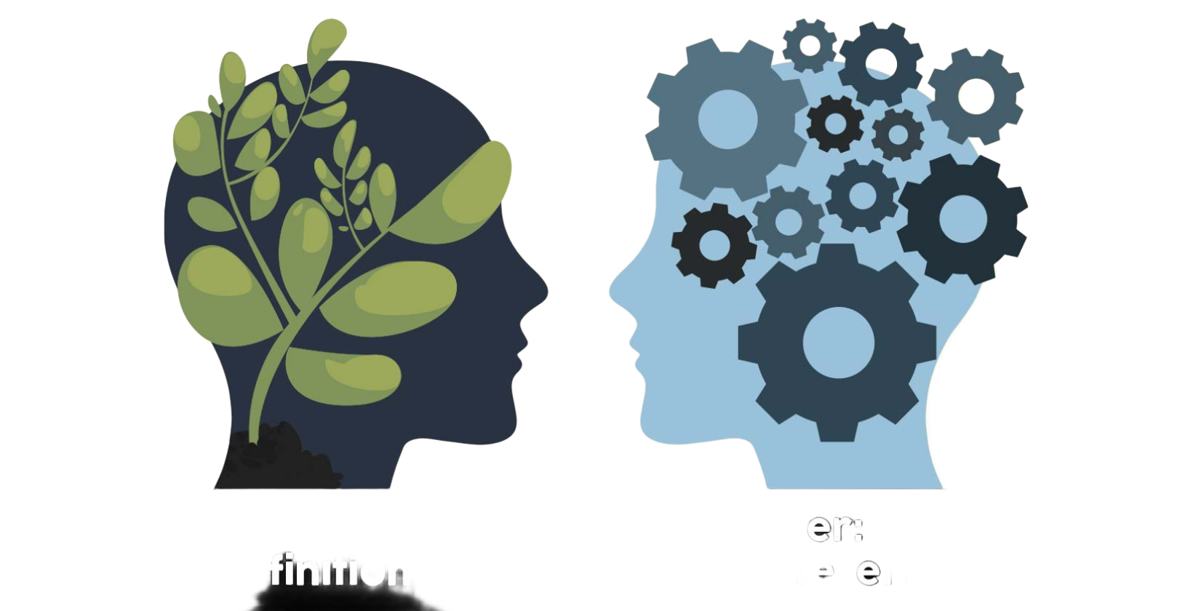
Personality & Character
Instructor: Ali Raza Abbass
MBA (UK), PGD. Strategic Management & Leadership (UK), BBA (Pak)
Certified Digital Marketer (META, Google, DMI UK)
Master Trainer

Slide 2
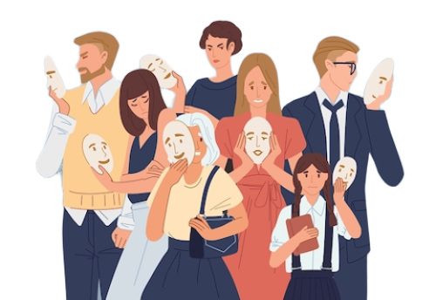
Introduction – Foundation of Ethical Action
Character: The sum of an individual's moral and ethical qualities; their consistent disposition towards good or bad actions. It's about who you are when no one is watching.
Personality: The combination of characteristics or qualities that form an individual's distinct character. It's about how you tend to behave and interact with the world.
Why does this matter in Ethics? Our character and personality profoundly influence our ethical decision-making and actions.

Slide 3

Character – A deeper Dive
Virtues: Positive character traits (e.g., honesty, courage, compassion, justice).
Vices: Negative character traits (e.g., dishonesty, cowardice, cruelty, injustice).
Moral Character: The strength and consistency of one's virtues. A person of strong moral character consistently acts in accordance with ethical principles.
The Development of Character: Character isn't innate; it's developed over time through habituation, education, experience, and reflection.

Slide 4
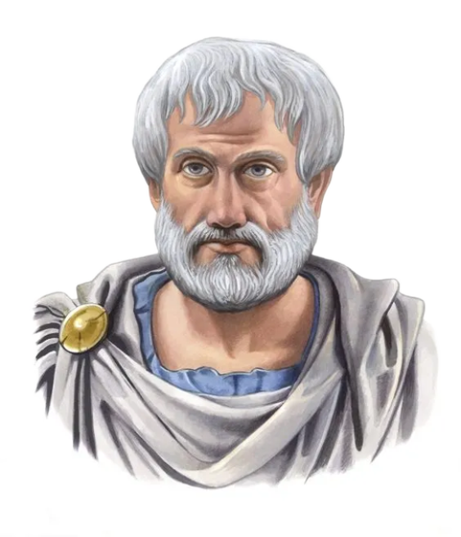
Aristotle and Virtue Ethics
Central Idea: Ethical action stems from good character. Focus on being a good person, rather than just doing good actions.
Eudaimonia (Flourishing): The ultimate goal of human life, achieved through living a virtuous life.
The Golden Mean: Virtues often lie between two extremes (vices).
Courage is the mean between cowardice and recklessness.
Generosity is the mean between stinginess and profligacy.

Slide 5
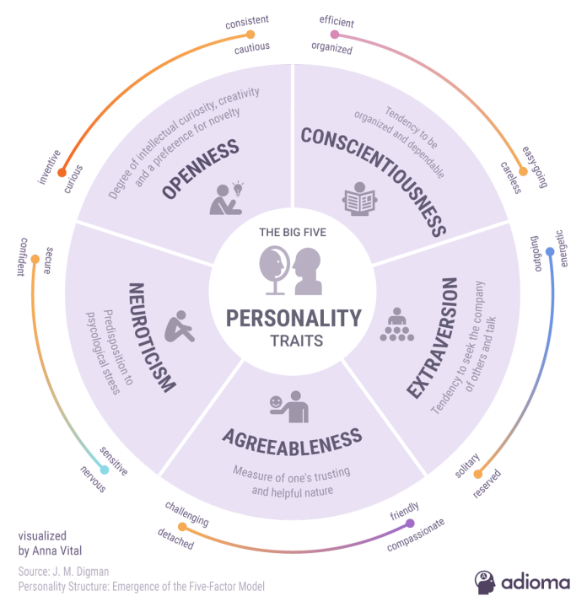
Personality - How We Engage
Big Five Personality Traits (OCEAN):
Openness to Experience: Imaginative, curious vs. practical, conventional.
Conscientiousness: Organized, disciplined vs. careless, impulsive.
Extraversion: Outgoing, energetic vs. solitary, reserved.
Agreeableness: Compassionate, cooperative vs. antagonistic, uncooperative.
Neuroticism: Anxious, insecure vs. calm, secure.
Temperament: Innate aspects of personality, often genetically influenced (e.g., reactivity, mood).

Slide 6
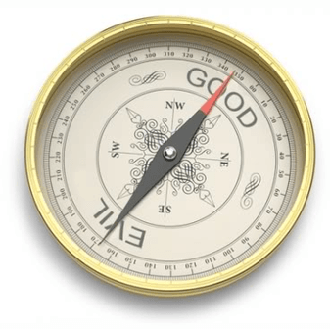
The Interplay: Character & Personality
Personality traits can make certain ethical actions easier or harder.
An agreeable person might find compassion easier to express.
A highly conscientious person might be more reliable in fulfilling duties.
Character provides the moral compass; personality influences how that compass is used in real-world situations.
Example: Two people may value honesty (character). One might be introverted (personality) and express honesty through quiet integrity, while another, extraverted, might be a vocal advocate for truth.

Slide 7
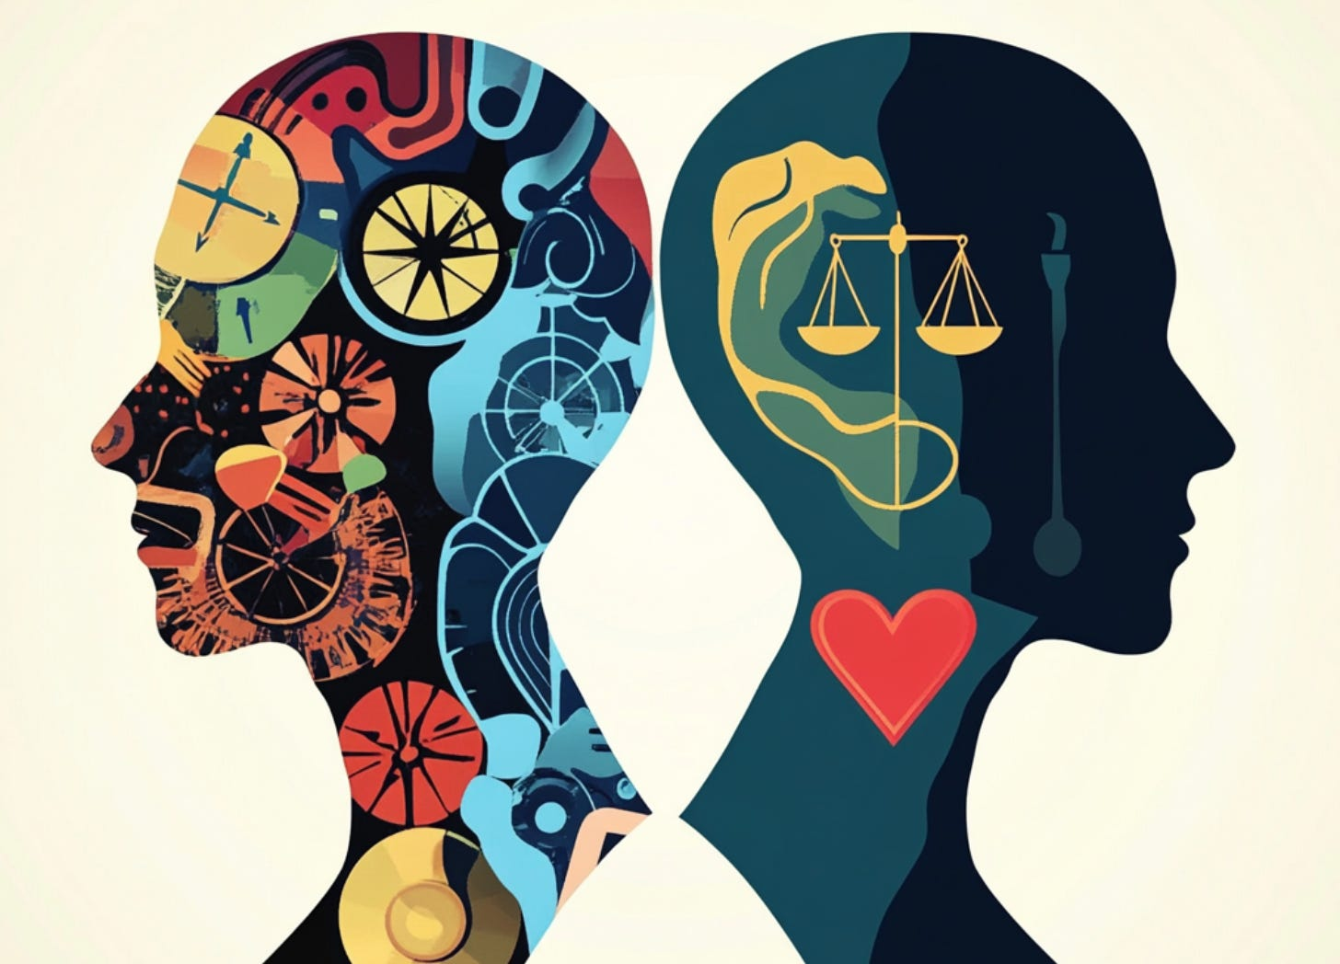
When Personality Challenges Character
Bias and Prejudice: Personality traits can sometimes predispose individuals to biases that challenge ethical character (e.g., low openness leading to resistance to new ideas or groups).
Self-Serving Bias: Our inherent desire to see ourselves positively can lead to rationalizing unethical behavior.
Situational Ethics: While character should be consistent, our personality might make us more susceptible to situational pressures that compromise our ethical resolve.

Slide 8
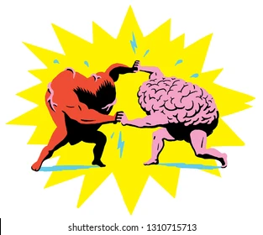
Nature vs. Nurture - Shaping Our Moral Selves
Nature (Innate Factors):
Genetics: Some predispositions for temperament and certain personality traits (e.g., neuroticism, extraversion) have a genetic component.
Early Brain Development: Biological factors can influence emotional regulation and impulse control.
Influence on Character: May make some virtues or vices naturally harder or easier to cultivate.
Nurture (Environmental Factors):
Upbringing & Parenting: Values instilled, role modeling, discipline, and emotional support.
Education: Formal learning, moral reasoning skills, exposure to diverse perspectives.
Social & Cultural Environment: Community norms, peer influence, societal expectations, media.
Life Experiences: Major events, challenges, successes, and relationships.
Influence on Character: Primarily shapes the development of virtues and the habituation of ethical behavior.
The Interaction: It's rarely one or the other. Our innate predispositions interact with our environment to forge our unique character and personality.
A genetic predisposition for impulsivity (nature) might be mitigated or exacerbated by parental guidance and social norms (nurture).
Ethical development is a dynamic process of managing natural tendencies through learned moral frameworks and practices.

Slide 9
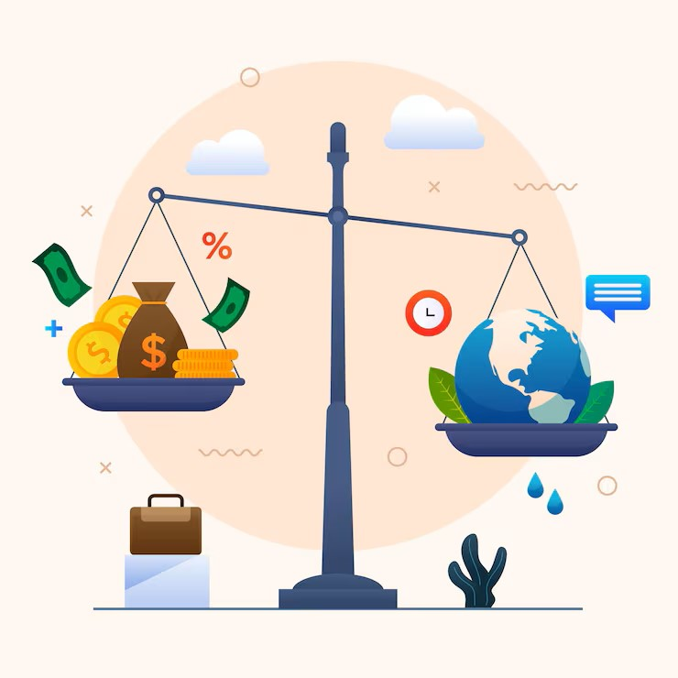
Cultivating Ethical Character
Self-Awareness: Understanding your own biases, strengths, and weaknesses.
Moral Imagination: The ability to envision various ethical outcomes and perspectives.
Practice and Habituation: Regularly choosing virtuous actions, even small ones, strengthens character.
Reflection: Learning from ethical dilemmas and personal failures.
Seeking Role Models: Observing and learning from individuals with strong moral character.

Slide 10
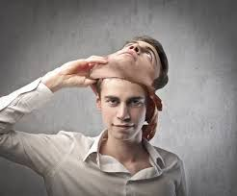
Can Personality Be Changed for the Better Ethically?
Core Traits vs. Behaviors: While core personality traits are relatively stable, our behaviors and habits can be modified.
Growth Mindset: Believing that one's abilities and intelligence can be developed through dedication and hard work (Dweck). This applies to ethical growth too!
Targeted Development: Focusing on specific areas where personality might hinder ethical action (e.g., consciously practicing empathy if naturally low in agreeableness).

Slide 11
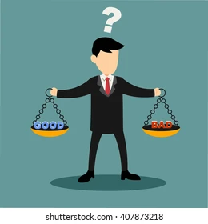
Character & Personality in Professional Ethics
Integrity: Essential for trust in any profession.
Responsibility: Taking ownership of actions and their consequences.
Professionalism: Behaving in a manner consistent with ethical standards, regardless of personal feelings.
Ethical Leadership: Leaders with strong character inspire moral behavior in others.

Slide 12
That’s all for today folks!!

